Slide 1
SUPPLY CHAIN DATA INTEGRATION SYSTEM
Building a robust data warehouse for end-to-end supply chain visibility.

Slide 2
Table of Contents
1. Project Overview & Objective
2. Technical Specifications
3. Design Solutions (HLD / LLD)
4. End-to-End Pipeline
5. Data Integrity & Orchestration
6. Visualizations & Business Impact

Slide 3

PROJECT OVERVIEW & OBJECTIVE
This project builds a data warehouse by transforming a single, flat BigQuery table (`Supply_Chain_Data`) into a high-performance star schema.
Curated datasets are stored in BigQuery as Dimension and Fact tables, with governance enabled by Slowly Changing Dimensions (SCD) Type 2.
The purpose is to create a "Single Source of Truth" for analytics and enable accurate historical, point-in-time reporting.
The system powers a Streamlit dashboard for business users to explore sales, profit, and customer trends.

Slide 4

TECHNICAL SPECIFICATIONS
Source: `Supply_Chain_Data` and FakeStore API tables in Google BigQuery from Kaggle
Processing: All transformations handled using the Medollain architecture rules to result the refined data.
Data Model: Star Schema with `Fact_Sales` and 5 dimensions (`Dim_Product`, `Dim_Customer`, `Dim_Location`, `Dim_Shipping`, `Dim_Date`).
Governance: SCD Type 2 implemented on `Dim_Product`, `Dim_Customer`, and `Dim_Location` to track historical changes.
Orchestration: SQL scripts designed to be run in sequence by a Python script, enabling automation via GCP Cloud
Visualization: End-user analytics delivered via a Streamlit dashboard.

Slide 5



DESIGN SOLUTIONS
HLD
LLD
High-Level Design: The conceptual flow of data from the source table to the end-user dashboard.
Low-Level Design: The detailed schema, including Star Schema structure and SCD Type 2 implementation.

Slide 6

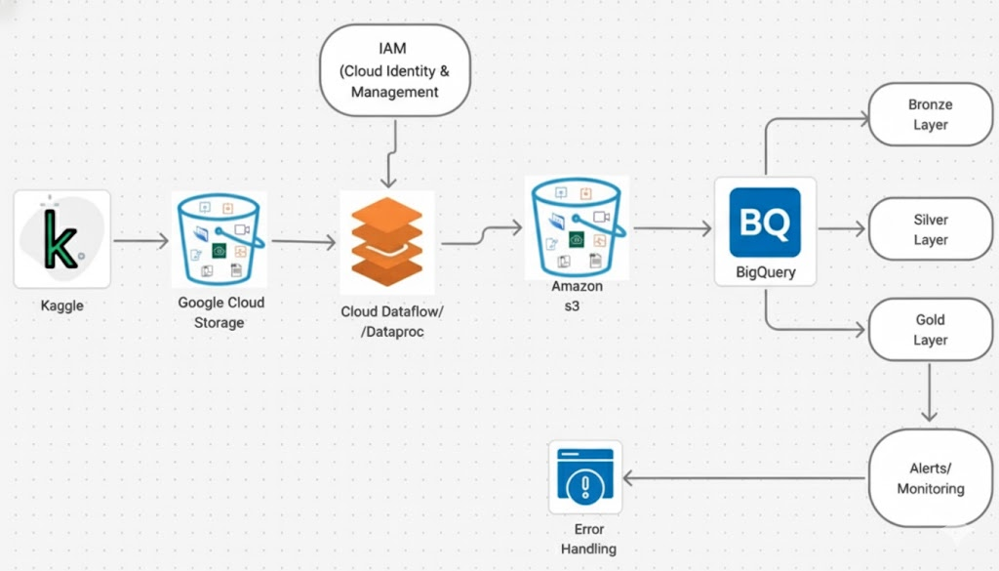
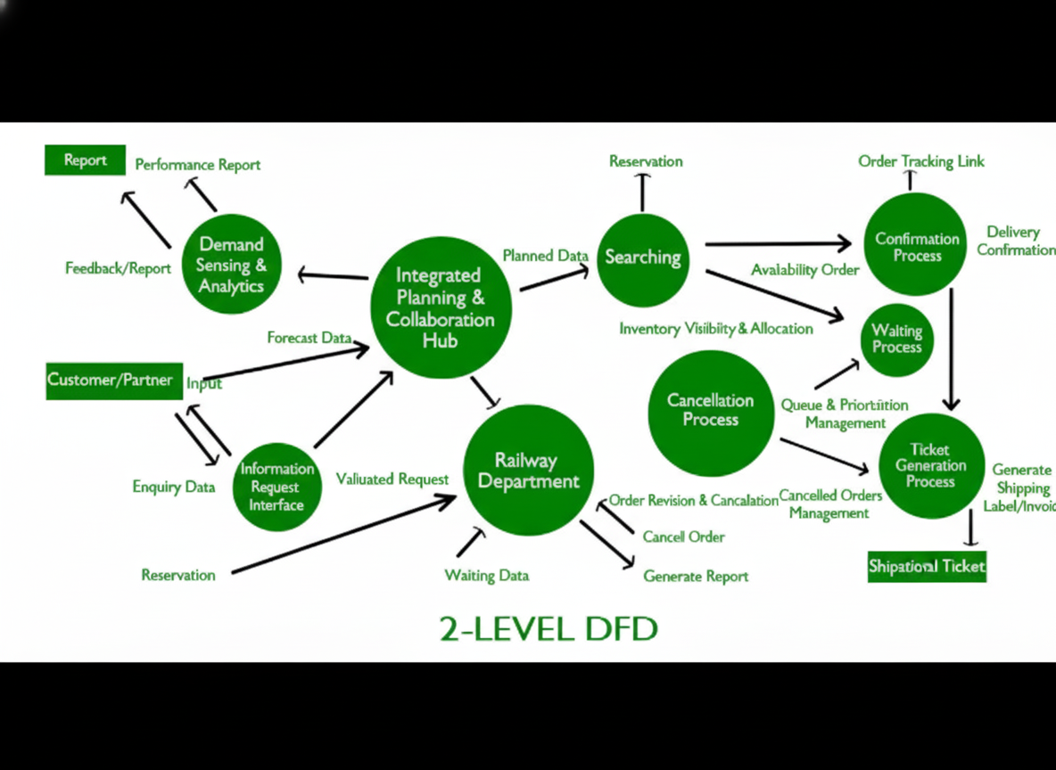

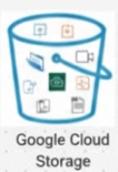
HIGH-LEVEL DESIGN
Conceptual Data Flow
•
Source: Data resides in the single `Supply_Chain_Data` table in BigQuery.
•
ETL (Transform): A Python-orchestrated SQL pipeline transforms the data in place.
•
Data Warehouse: Data is loaded into the new Star Schema (5 Dimensions, 1 Fact Table) using BigQuery
•
Analytics: The Streamlit dashboard visualizes the business insights

Slide 7

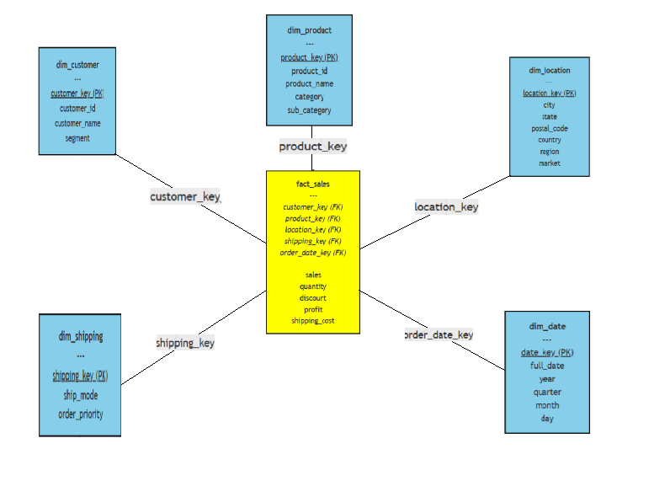
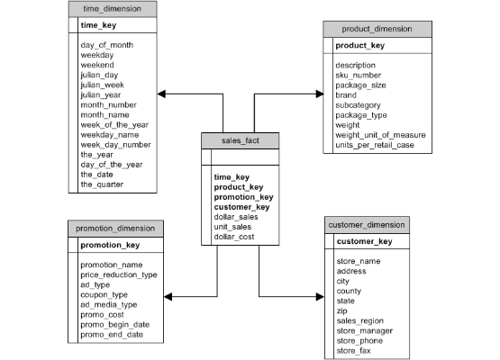
LOW-LEVEL DESIGN - STAR SCHEMA
Schema Details
•
Fact Table: `Fact_Sales` (Center) - Stores all measures (Sales, Profit, Quantity) and foreign keys.
•
Dimensions:
•
`Dim_Product` (SCD Type 2)
•
`Dim_Customer` (SCD Type 2)
•
`Dim_Location` (SCD Type 2)
•
`Dim_Shipping` (Static)
•
`Dim_Date` (Static)
•
SCD Join Logic: Historical joins use `Order Date BETWEEN start_date AND end_date` for point-in-time accuracy.

Slide 8
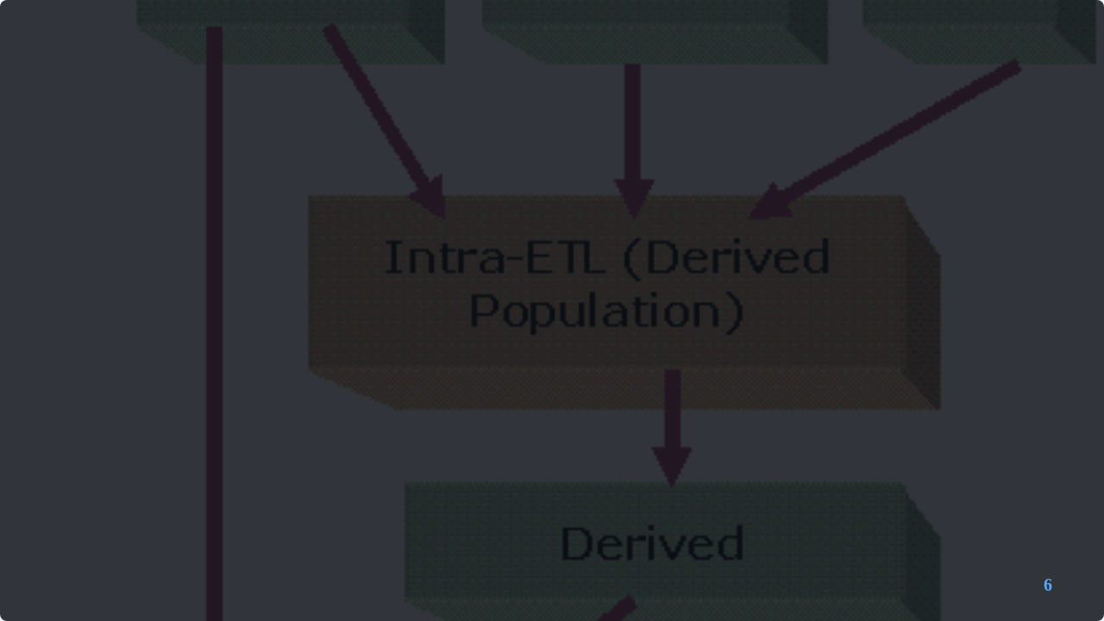
END-TO-END PIPELINE - STAGING TO STAR SCHEMA
✓
Start: Trigger the main Python script orchestration.
✓
Drop & Recreate: `CREATE OR REPLACE TABLE` commands run for all 5 dimensions and 1 fact table.
✓
Load Static Dimensions: `INSERT INTO` scripts run for `Dim_Date` and `Dim_Shipping`.
✓
Load SCD Dimensions: `INSERT INTO` scripts with window functions run for `Dim_Customer`, `Dim_Product`, & `Dim_Location`.
✓
Load Fact Table: The final `INSERT INTO...SELECT...JOIN` script runs, performing point-in-time lookups to populate `Fact_Sales`.
✓
End: Pipeline complete and data is ready for analysis.

Slide 9

DATA INTEGRITY & QUALITY CHECKS
NULL Prevention: `WHERE...IS NOT NULL` clauses are used during dimension creation to ensure business keys are valid.
SCD Type 2 Join Logic: The `start_date AND end_date` join condition ensures that every fact record links to the *correct historical version* of a dimension.
Referential Integrity: `LEFT JOIN` is used when building the fact table. This prevents data loss if a dimension record is missing and allows `NULL` keys for later analysis.
Type Casting: All measures (`Sales`, `Quantity`) are explicitly `CAST` to their correct data type (e.g., `FLOAT64`, `INT64`) during the final fact table load.

Slide 10

PIPELINE ORCHESTRATION
Workflow Management: The pipeline is orchestrated as a series of dependent SQL queries, executed in a precise order by a master Python script.
Idempotency: The entire pipeline is fully re-runnable. `CREATE OR REPLACE TABLE` ensures tables are always in a clean state before loading.
Scalability: All heavy lifting is done by BigQuery SQL, which scales automatically. The Python script is a lightweight orchestrator.
Future Automation: This script can be scheduled via GCP Cloud Composer, Airflow, or GCP Cloud Scheduler for nightly batch runs.

Slide 11

ALERTS, MONITORING, LOGGING
Job Logging: All SQL query executions, successes, and failures are automatically logged in the BigQuery Job History for auditing and troubleshooting.
Performance Monitoring: BigQuery query performance (slots used, time taken) can be monitored via GCP Cloud Monitoring and the BigQuery UI.
Cost Monitoring: GCP Budgets and alerts can be set on the BigQuery project to prevent unexpected costs.

Slide 12

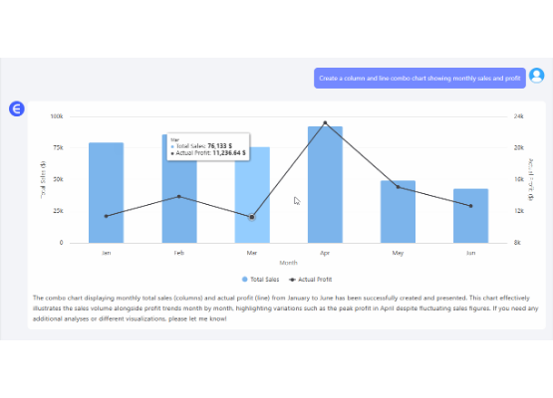
VISUALIZATIONS
Monthly Sales & Profit Trend
This time-series chart, built by querying the `Fact_Sales` and `Dim_Date` tables, allows users to track performance over time and identify seasonal trends or anomalies.

Slide 13
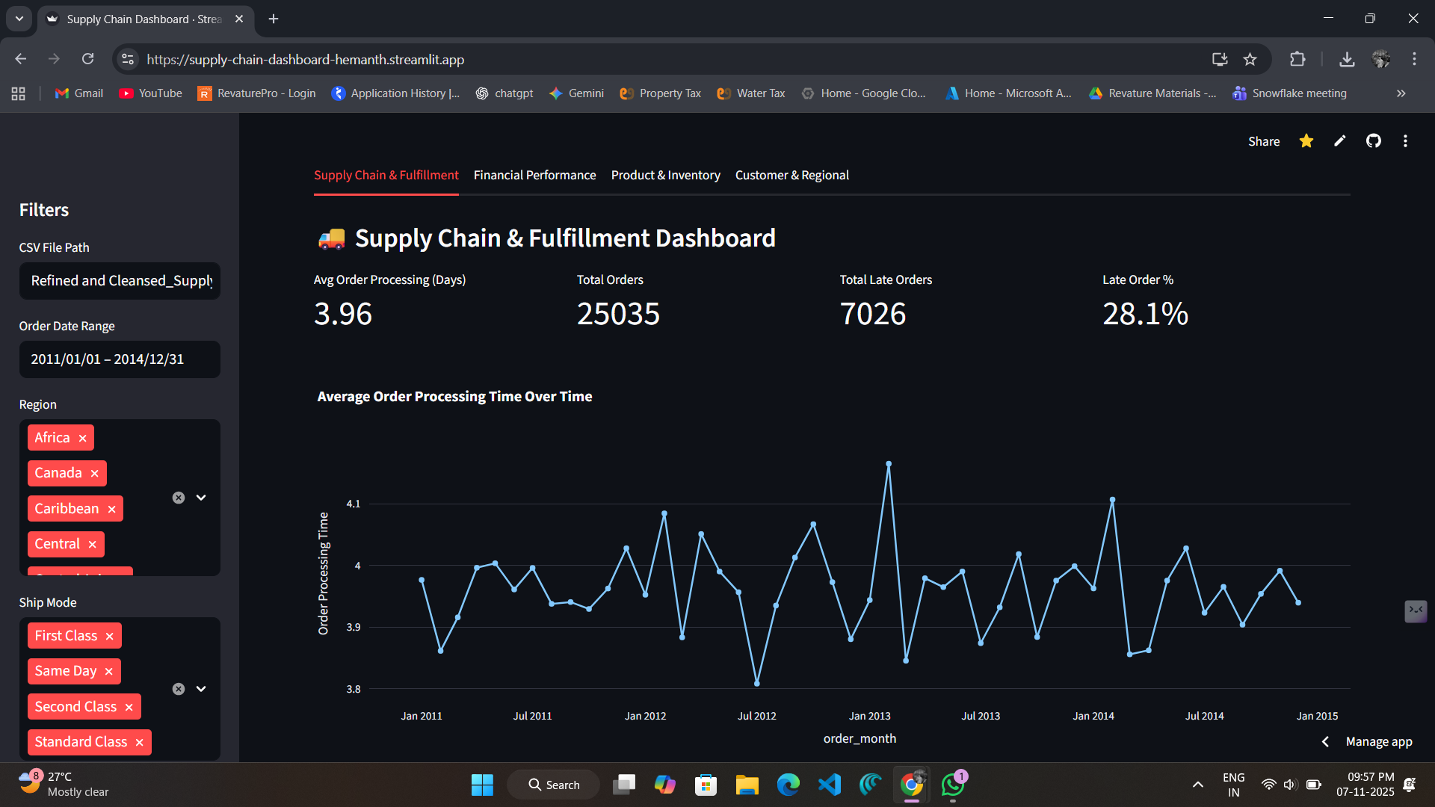
VISUALIZATIONS - KPIs
KPIs & Map Analysis
The dashboard leads with key performance indicators (KPIs) like Total Sales, Total Profit, and Avg. Shipping Days. A dynamic choropleth map visualizes sales and profit by state, allowing for easy identification of top-performing regions.

Slide 14
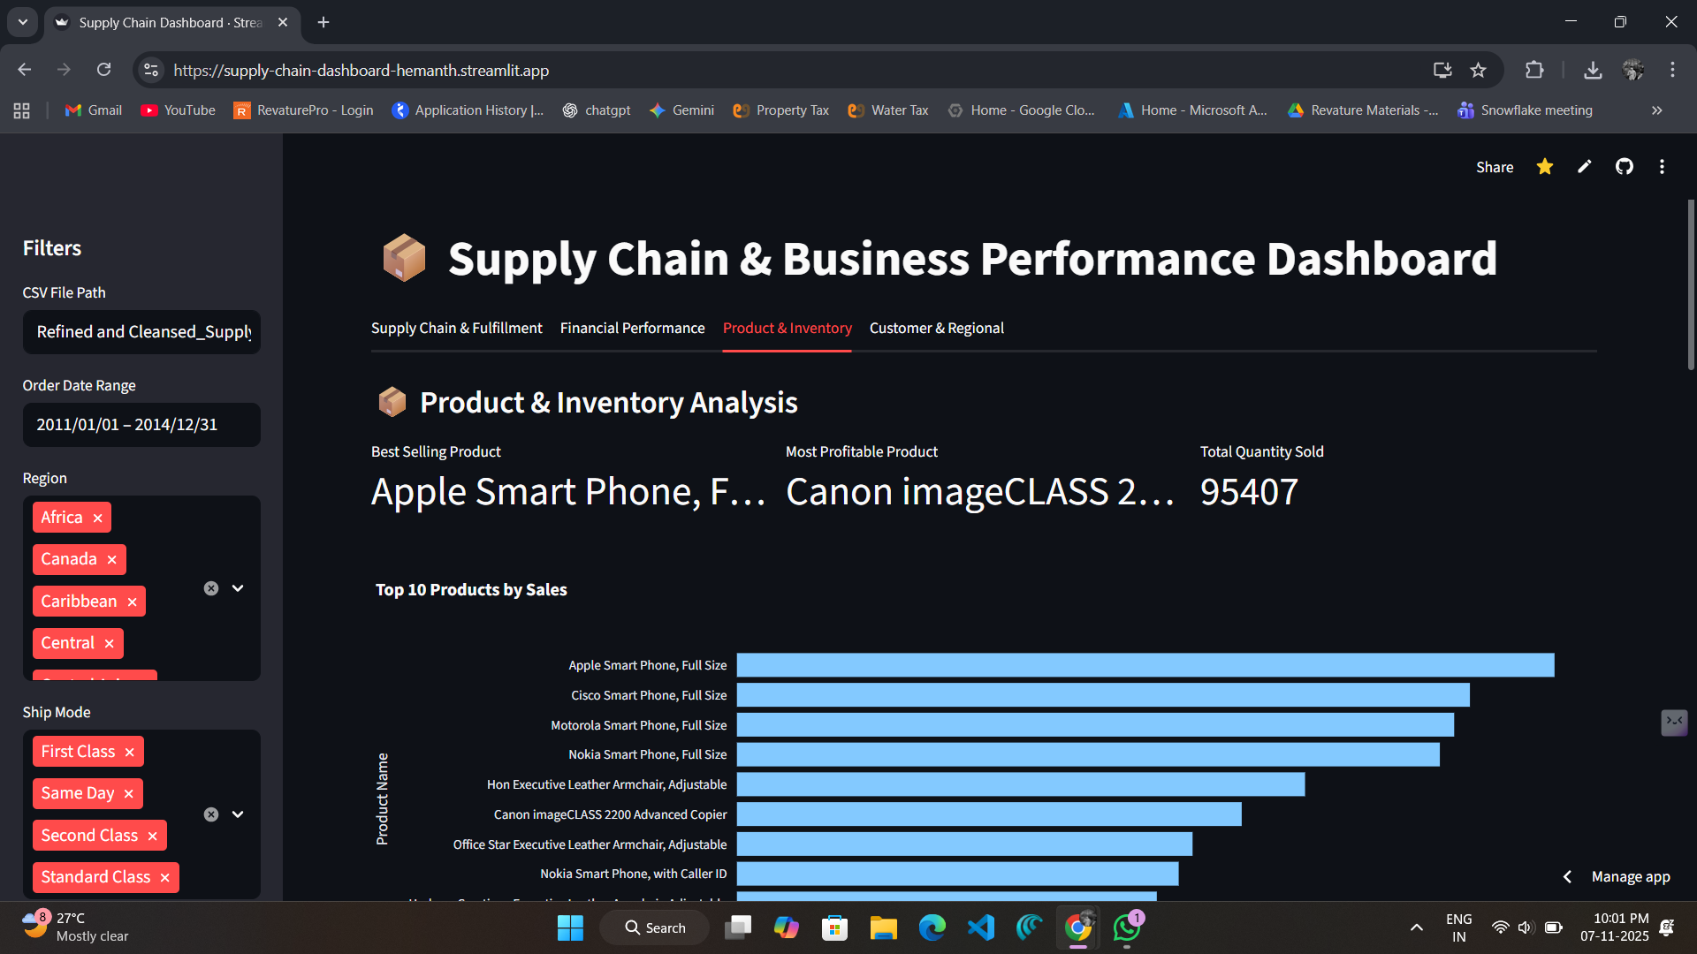
VISUALIZATIONS - DEEP-DIVE ANALYSIS
Product & Segment Profitability
Interactive bar charts allow users to drill down from Category to Sub-Category, analyzing both profit and sales. Filters for region, ship mode, and customer segment enable granular, deep-dive analysis to find the most and least profitable items.

Slide 15

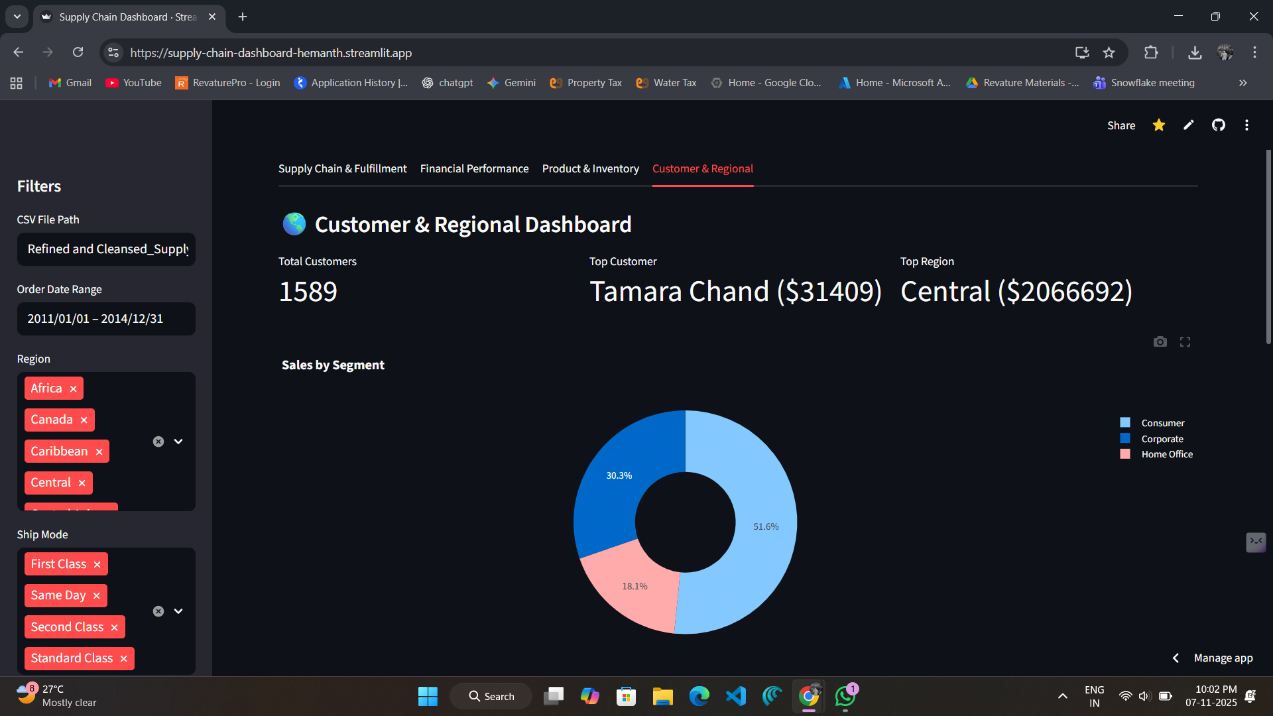
VISUALIZATIONS
Sales by Customer Segment
This chart joins `Fact_Sales` with `Dim_Customer` to provide a clear breakdown of revenue by segment. This helps answer "Who are our most valuable customers?"

Slide 16

TYPE OF TESTING DONE
Unit Testing: Verified SCD Type 2 logic for a single customer change. Checked row counts from `SELECT DISTINCT` against dimension table counts.
Integration Testing: Executed the end-to-end Python script to validate the flow (Dimensions must load before Facts).
Data Validation: Ran aggregate queries (e.g., `SUM(Sales)`) on both the source table and the fact table to ensure no measures were lost.
Dashboard Testing: Connected the Streamlit dashboard to the *new* star schema tables and confirmed all charts render correctly.

Slide 17

BUSINESS IMPACTS & OUTCOMES
Historical Accuracy: Enables true point-in-time analysis (e.g., "What was our profit by segment *before* the customer definitions changed?").
Single Source of Truth: Creates a clean, reliable, and governed data warehouse for all business analytics, eliminating data silos.
High-Performance Analytics: The star schema is highly optimized for BigQuery, resulting in fast-loading and interactive dashboards.
Scalable & Maintainable: The automated, idempotent pipeline is easy to maintain and scales effortlessly with data growth in BigQuery.

Slide 18
Thank You

